Slide 1
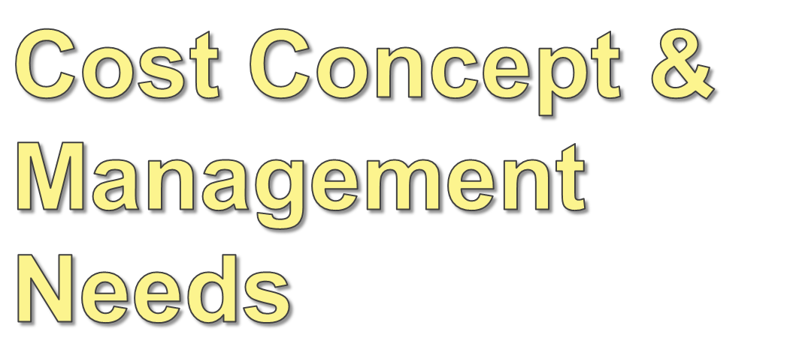
Notes:
Chapter 6 – Cost Behavior and Relevant Costs

Slide 2
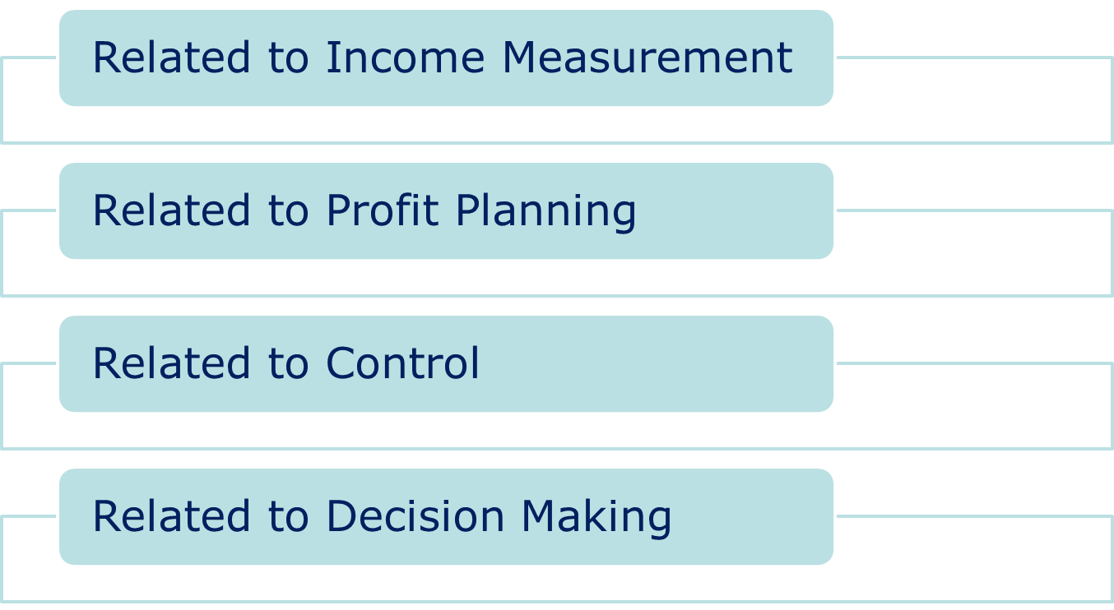
Cost Concepts

Slide 3
Cost for the purpose of Income Measurement
Non Manufacturing Cost: not associated with manufacture of goods or provisions of services.
Manufacturing Cost: associated with manufacture of goods or provisions of services.

Slide 4
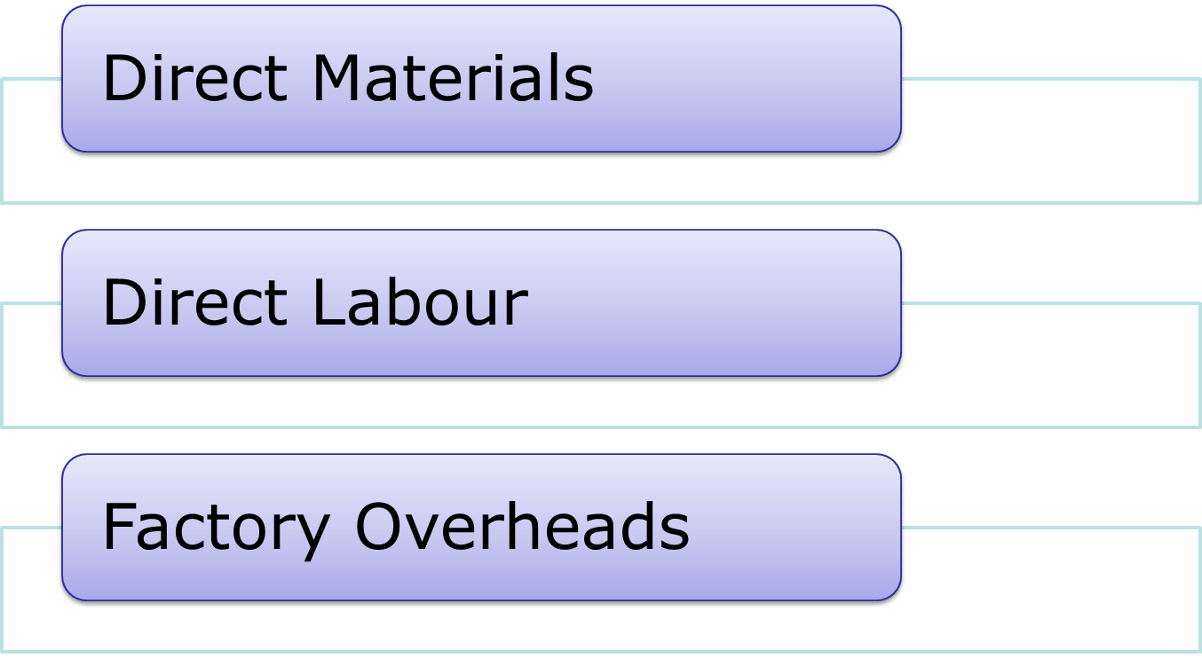
Manufacturing Cost

Slide 5
Manufacturing Cost
Direct Material are those materials that are directly traceable to the goods or services being produced. Direct materials can be directly charged to products.
Material that become a part of the tangible product or that are used in providing a service are classified as direct material.
Notes:
Eg. Leather used in shoe making (Product industry); Food articles used in hotel (Service industry)

Slide 6
Manufacturing Cost
Direct Labour is that human effort which can be directly traced to the cost object by physical observation.
Factory Overheads comprises of all indirect manufacturing costs which cannot be identified with specific units of finished products.
Notes:
Eg. Assembly line workers (manufacturing industry); Pilots in airlines (Service industry)

Slide 7
Manufacturing Cost
Factory Overheads
Indirect Material consists those items of materials which are used in the process of production but do not become part of the finished product.
Notes:
Eg. Grease, lubricants etc.

Slide 8
Manufacturing Cost
Factory Overheads
Indirect Labour is that human effort which is required to perform manufacturing process cannot be directly traced to the cost object by physical observation.
Notes:
Eg. Remuneration paid to supervisors

Slide 9
Manufacturing Cost
Factory Overheads
Indirect Expenses are those expenses which are not directly with manufacturing process like factory rent, depreciation of plant & machinery.

Slide 10
Non Manufacturing Cost
Selling Costs
General & Administrative Costs
Research & Development Costs

Slide 11
Cost for the purpose of Profit Planning
As production volume changes, some costs may increase or decrease and other costs may remain stable.
However, the predictability of specific costs to change with volume provides an important tool for managerial accountants.
Notes:
As production volume changes, some costs may increase or decrease and other costs may remain stable, but specific costs behave in predictable ways as volume changes. This concept of predictable cost behavior based on volume is the focus of Chapter 3 and provides an important tool for the effective use of accounting information in managerial decision making.

Slide 12
Fixed Costs
Fixed costs stay the same in total.
They vary when expressed on a per unit basis.
Notes:
Fixed costs are costs that remain the same in total but vary per unit when production volume changes. Facility-level costs, such as rent, depreciation of a factory building, the salary of a plant manager, insurance, and property taxes, are likely to be fixed costs.

Slide 13
Variable Costs
Variable costs vary in direct proportion to volume changes.
They are constant when expressed as per unit amounts.
Notes:
As production increases, variable costs increase in direct proportion to the change in volume; as production decreases, variable costs decrease in direct proportion to the change in volume. Examples include direct material, direct labor (if paid per unit of output), and other unit-level costs, such as factory supplies and energy costs to run factory machinery.

Slide 14
Relevant Range
The relevant range is the normal range of production that can be expected for a particular product and company.
The relevant range can also be viewed as the volume of production for which the fixed and variable cost relationships hold true.
Notes:
The relevant range is the normal range of production that can be expected for a particular product and company. The relevant range can also be viewed as the volume of production for which the fixed and variable cost relationships hold true.

Slide 15
Step Costs
Costs that vary with activity in steps and may look like be treated as either variable cost or the fixed cost. Such type of cost may be treated as fixed if they remain constant within a range.

Slide 16
Relevant Cost and Cost Behavior
In general variable cost are relevant in production decisions because they vary with the level of production.

Slide 17
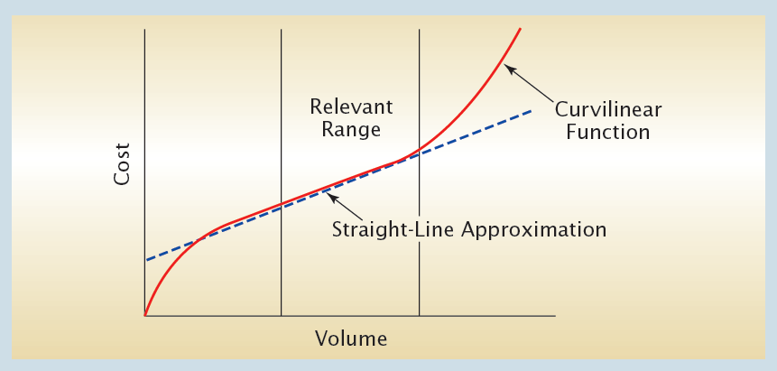
Types of Information Needed By
External Users
The concept of the relevant range allows managerial accountants to assume a linear cost relationship.
Notes:
In reality, costs may behave in a curvilinear fashion. However, the concept of the relevant range allows managerial accountants to assume a linear cost relationship. In other words, within this narrower range of production, a curvilinear cost can be approximated by a linear relationship between the cost and volume.

Slide 18
The Cost Equation
Expressing the link between costs and production volume as an algebraic equation is useful.
The equation for a straight line is:
y = a + bx
Notes:
Expressing the link between costs and production volume as an algebraic equation is useful. The cost equation can be expressed as a straight line or Y = a + bx.

Slide 19
The Cost Equation
Using y = a + bx, the a in the equation is the point where the line intersects the vertical (y) axis and b is the slope of the line.
Using y = a + bx,
if y is total direct material costs and
x is units produced, then y = Rs.0 + Rs.1,000x.
For y = Rs.0 + Rs.1,000x,
the y intercept is zero and slope of the line is 1,000.
Notes:
Using y = a + bx, the a in the equation is the point where the line intersects the vertical (y) axis and b is the slope of the line.

Slide 20
The Cost Equation
y = Rs.0 + Rs.1,000x,
For every one-unit increase (decrease) in production (x), direct material costs increase (decrease) by Rs. 1,000.
If y = rent cost and x = units produced,
y = Rs.500,000 + Rs.0x.
In this case, the y intercept is Rs.500,000 and the slope is zero. In other words, fixed costs are Rs.500,000 at any level of production within the relevant range.

Slide 21
Mixed Costs
Mixed costs have both a fixed and a variable component.
They are costs that change in total and also change per unit.
If you can’t draw a straight line through all the data points (below), then it is mixed.
Notes:
Mixed costs present a unique challenge because they include both a fixed and a variable component. If a cost does not vary in direct proportion to changes in the level of production (in other words, you can’t draw a straight line through all the data points), it is a mixed cost. This is because a mixed cost has a component that is constant regardless of production volume.

Slide 22
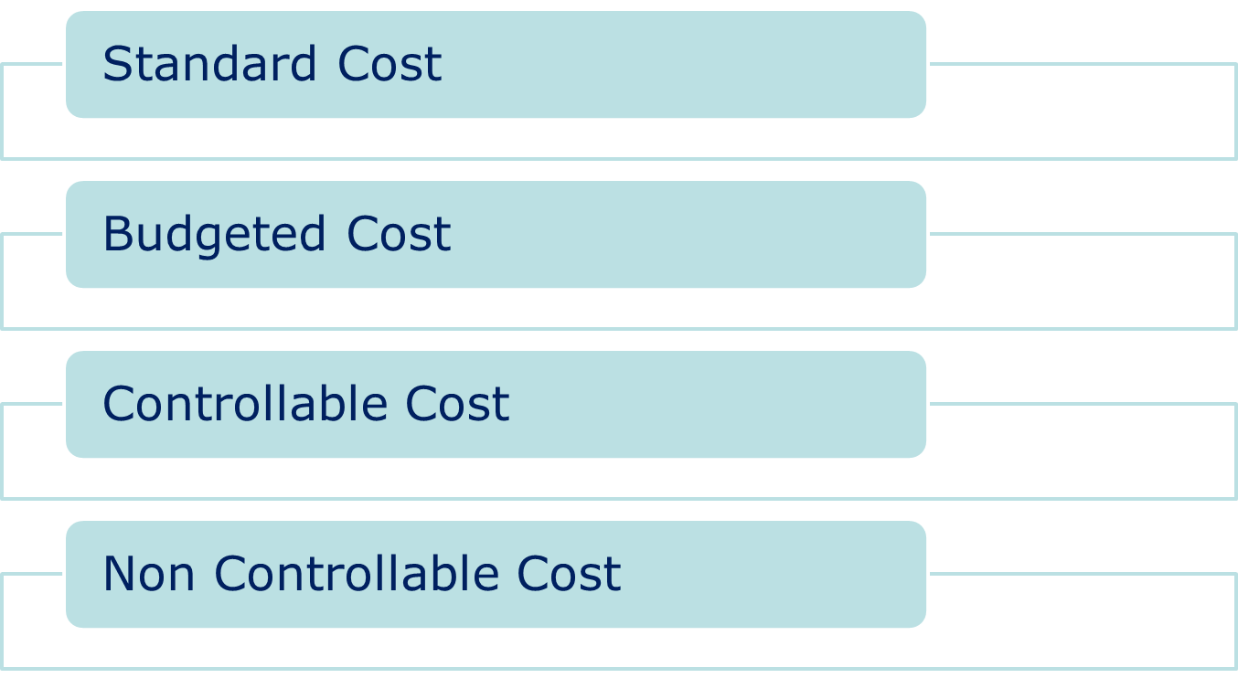
Cost Concept Related to Control

Slide 23
Cost Concept Related to Control
Standard Cost are predetermined cost under the given operating conditions; expressed on per unit basis
Budgeted cost are expected to be incurred for the planned activities of an enterprise for a specified period of time; expressed as total; generally based on standard cost

Slide 24
Cost Concept Related to Control
Controllable cost are those cost which can be controlled to real significant extent by an action of an individual at a specific responsibility level within a specific time span.
Non Controllable cost are those cost which are not subject to the direct authority and action of an individual.

Slide 25
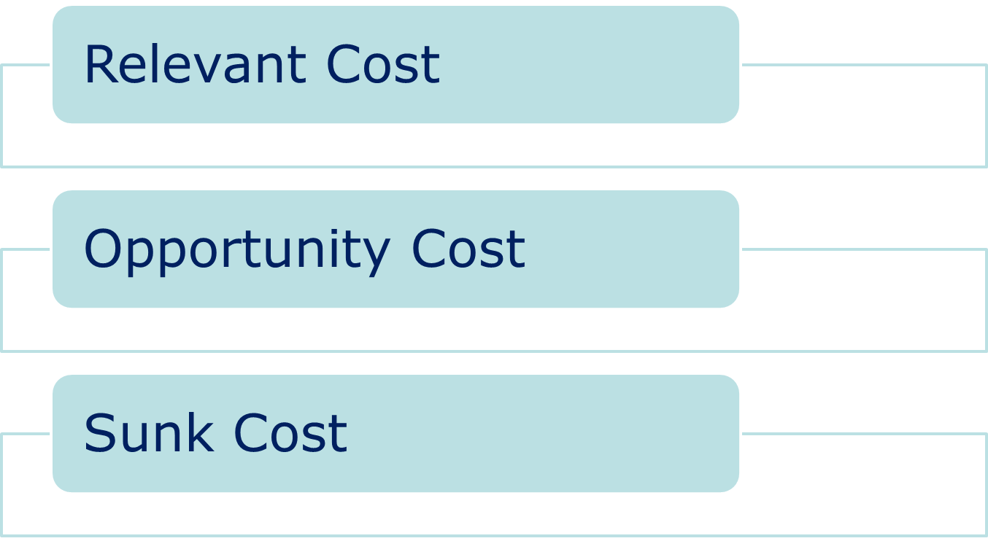
Cost Concept Related to Decision Making

Slide 26
Relevant Costs
These are avoidable or can be eliminated by choosing one alternative over another.
For Example: Buying a car with a CD changer versus buying a car without one.

Slide 27
Sunk Costs
These are costs that have already been incurred. They cannot be avoided and are irrelevant.
For Example: Watching a horrible rental movie that is unbearable during its first 20 minutes. The rental fee is a sunk cost. You can either decide to stick it out or use the time to do something more fun.

Slide 28
Opportunity Costs
These are benefits forgone by choosing one alternative over
another. They are relevant.
For Example: Choosing to go to college or work full-time. The opportunity cost is the higher salary you will receive as a college graduate. (In general, these costs are hard to quantify.)

Slide 29
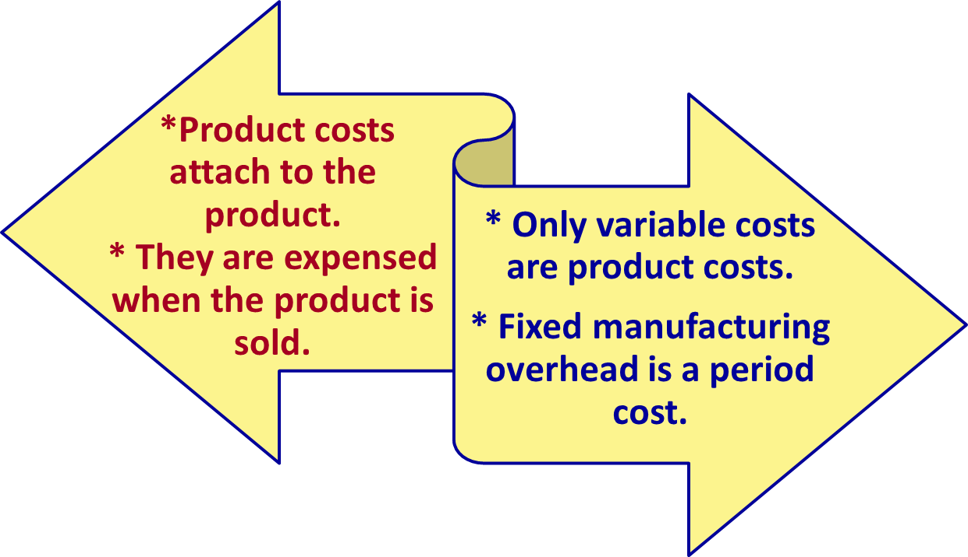
A Comparison of
Absorption Costing and Variable Costing
Absorption Costing
Variable Costing
Notes:
Two key costing methods include absorption costing and variable costing. Absorption costing (or full costing) treats all manufacturing costs, both fixed and variable, as product costs. Under this approach product costs attach to the product and are expensed when the product is sold. Alternatively, variable costing, also called direct costing, treats only variable costs as product costs. As such fixed manufacturing overhead is treated as a period cost.

Slide 30
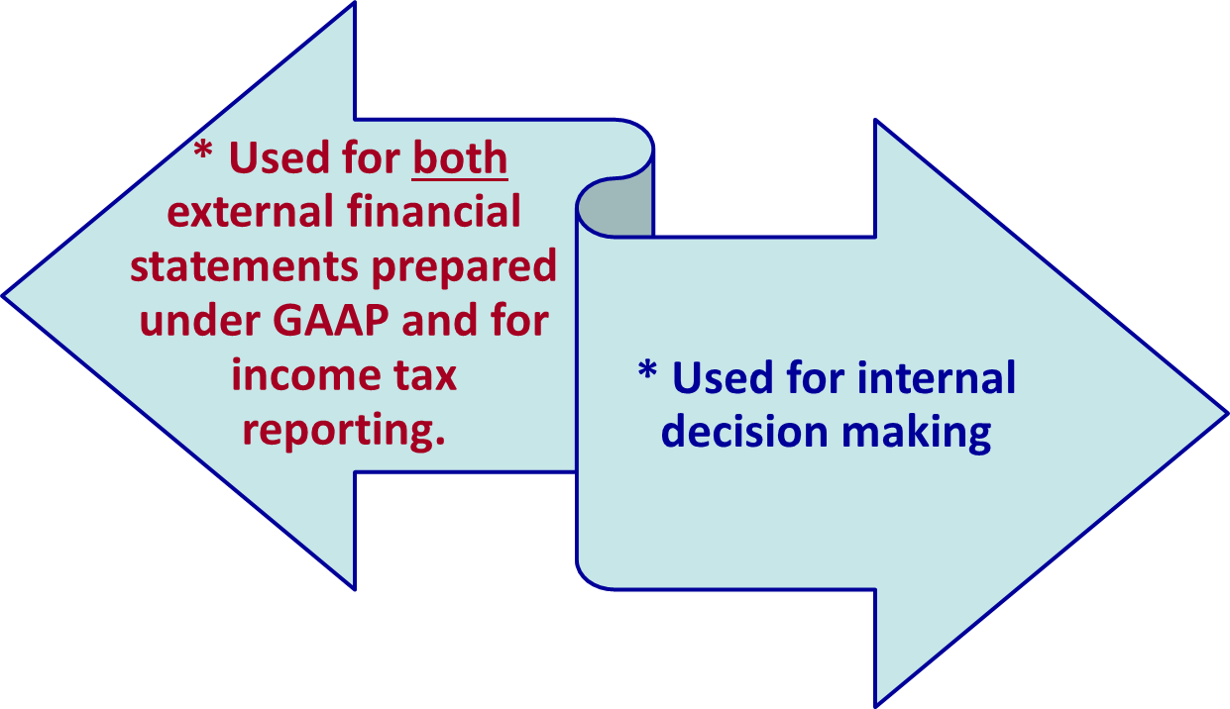
A Comparison of
Absorption Costing and Variable Costing
Absorption Costing
Variable Costing
Notes:
For reporting purposes, absorption costing is required for external financial statements prepared under GAAP and for income tax reporting. However, since variable costing is more consistent with the focus of cost-volume-profit analysis on differentiating fixed from variable costs, it provides useful information for internal decision making.

Slide 31
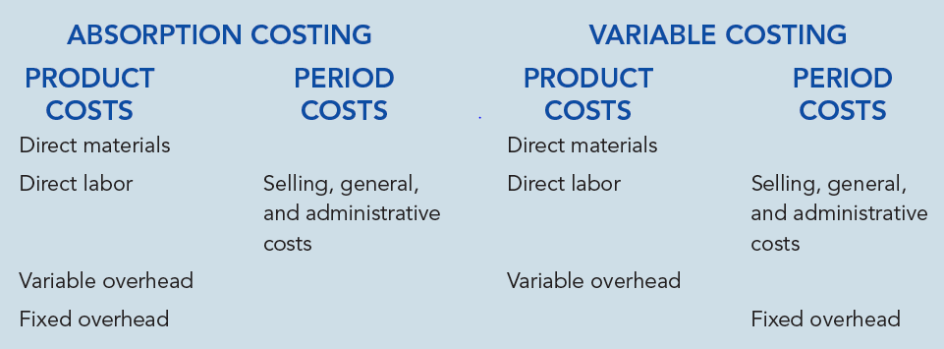
A Summary of
Absorption Costing and Variable Costing
Notes:
As you can see, the only difference between absorption and variable costing is the treatment of fixed overhead. The impact of this difference on reported income becomes evident when a company’s production and sales are different (i.e., the number of units produced is greater than or less than the number of units sold).

Slide 32
Example
 | Year 1 | Year 2 | Year 3
Production(Units) | 10000 | 10000 | 10000
Sales (units) | 10000 | 5000 | 15000
Sales price per unit Rs 12
Variable cost per unit Rs 6
Fixed cost at normal capacity Rs 40000
Standard fixed overhead rate Rs 4 per unit
Show the profit under variable and absorption costing in different years

Slide 33
Income statements
Absorption costing
Sales 1,20,000
Less : COGS 1,00,000
Gross Profit 20,000
Less: Non-mfging cost NIL
Net Income 20,000
Variable Costing
Sales 1,20,000
Less : COGS (VC) 60,000
Contribution 60,000
Less: FC 40,000
Net Income 20,000

Slide 34
Income statements
Absorption costing
Sales 60,000
Less: COGS 50,000
Gross Profit 10,000
Less: Non-mfging cost NIL
Net Income 10,000
Cost of inventory (50,000)
Variable Costing
Sales 60,000
Less : COGS (VC) 30,000
Contribution 30,000
Less: FC 40,000
Net Income (10,000)
Cost of inventory (30,000)

Slide 35
Income statements
Absorption costing
Sales 180,000
Less: COGS 1,50,000
Gross Profit 30,000
Less: Non-mfging cost NIL
Net Income 30,000
Cost of inventory 50,000
Variable Costing
Sales 180,000
Less : COGS (VC) 90,000
Contribution 90,000
Less: FC 40,000
Net Income 50,000
Cost of inventory 30,000

Slide 36
When units produced exceed units sold, absorption costing will report higher net income than variable costing.
When units sold exceed units produced, variable costing will report higher net income than will absorption costing.
When units sold equal units produced, variable costing will report the same net income than will absorption costing.
Notes:
Notice in Year 2 when units produced is greater than units sold, absorption costing reports higher net income than variable costing.

Slide 37
Problems with Absorption Costing
The use of absorption costing for internal decision making can result in less than-
optimal decisions.
For Example: By increasing production, unethical managers can increase income, reduce cost of goods sold, meet their own bonus goals, and saddle the company with the costs of unsold inventory and storing/insurance costs.
Notes:
Although absorption costing is required for external reporting, it typically results in less than optimum internal decision-making. In particular, it can be used by unethical managers to receive personal rewards at the expense of what is best for the company. For example, by increasing production, unethical managers can increase net income, which is often tied to bonuses. Thus, cost of goods sold is reduced, bonus goals are met, but the company is saddled with the costs of unsold inventory and other costs like storage and insurance. While this is unsustainable in the long-run, managers who do this may just continue on to a new job before the problems of excessive inventory are uncovered.

Slide 38
Choosing the Best Method for Performance Evaluation
For external reporting and income tax filing, managers have no choice but to use absorption costing, as it is required by GAAP.
However, using variable costing for internal decision making removes the impact of changing production levels on income and is best for performance evaluation of managers.
Notes:
While external reporters have no choice in avoiding absorption costing, internal decision makers do. Using variable costing for internal decision making removes the impact of changing production levels on income and is best for performance evaluation of managers.

Slide 39
Five Advantages of Variable Costing
Changes in production and inventory levels do not impact the calculation of
profits.
1
3
2
4
5
Notes:
For the most part, variable costing focuses on advantages related to managerial performance and cost behavior. More specifically, with variable costing, changes in production and inventory levels do not impact the calculation of profits.

Slide 40
Five Advantages of Variable Costing
Variable costing focuses attention on relevant product costs rather than on fixed product costs, which are often unavoidable.
1
3
2
4
5
Notes:
Secondly, variable costing focuses attention on relevant product costs rather than on fixed product costs, which are often unavoidable.

Slide 41
Five Advantages of Variable
Costing
1
Under variable costing, cost behavior is emphasized and fixed costs are
separated from variable costs on the income statement.
3
2
4
5
Notes:
Third, under variable costing, cost behavior is emphasized and fixed costs are separated from variable costs on the income statement.

Slide 42
Five Advantages of Variable
Costing
1
3
Variable costing is consistent with the use of variance analysis.
2
4
5
Notes:
A fourth advantage of variable costing is that it is consistent with the use of variance analysis, which is an important tool used to manage a business.

Slide 43
Five Advantages of Variable
Costing
1
3
2
4
Variable costing income is more closely aligned with a company’s cash
flows.
5
Notes:
Finally, variable costing has the advantage of providing income that is more closely aligned with a company’s cash flows.

Slide 44
Example:
A jeweler produces 100,000 units of lockets each year with the following per unit costs: direct material of Rs 15, direct labor of 17.50 Rs and variable overhead cost of Rs. 5 and Fixed Overhead Cost of 15,00,000 Rs. The company also has variable selling and administrative costs of 2.50 Rs. per unit sold, and fixed selling and administrative costs of 5,00,000 Rs.
The selling price of each locket is Rs.100

Slide 45
Variable costing Vs. Absorption costing under following conditions:
In year 1, let’s assume that all 1,00,000 units that are produced are sold.
Let’s suppose next year, the jeweler produces 1,00,000 units (for the same costs), but due to a very slow Christmas season only sells 80,000 units.
In year 3, the jeweler holds production constant at 1,00,000 units, but increases sales to 1,20,000 units (the 20,000 units left over from year 2 were sold in addition to all of the production for the third year).

Slide 46
The cost of one unit of product under absorption and variable costing is calculated as follows:
Product Costs
Absorption costing |  | Variable costing
Direct material | 15 Rs | Direct material | 15 Rs
Direct labor | 17.50 Rs
 |  | Direct labor | 17.50 Rs
Variable overhead | 5 Rs
 |  | Variable overhead | 5 Rs
Fixed overhead | 15 Rs
 |  | Total per unit | 37.50 Rs
Total per unit | 52.50 Rs

Slide 47
 | YEAR1 | YEAR2 | YEAR3 | TOTAL
PRODUCTION | 100000 | 100000 | 100000 | 300000
SALES | 100000 | 80000 | 120000 | 300000
ABSORPOTION COSTING
SALES | 10000000 | 8000000 | 12000000 | 30000000
LESS : COGS | 5250000 | 4200000 | 6300000 | 15750000
GROSS MARGIN | 4750000 | 3800000 | 5700000 | 14250000
LESS : S&A COSTS | 750000 | 700000 | 800000 | 2250000
NET INCOME | 4000000 | 3100000 | 4900000 | 12000000
Notes:
Rs. 5,00,000, fixed S&A Expenses, is a non-manufacturing cost and not traceable with the product like manufacturing overhead cost. So it is treated as period cost even in Absorption costing method.

Slide 48
 | Year1 | Year2 | Year3 | TOTAL
Variable costing
Sales | 10000000 | 8000000 | 12000000 | 30000000
Less : variable cost | 4000000 | 3200000 | 4800000 | 12000000
Contribution margin | 6000000 | 4800000 | 7200000 | 18000000
Less : Fixed costs | 2000000 | 2000000 | 2000000 | 6000000
Net income | 4000000 | 2800000 | 5200000 | 12000000
Notes:
Both fixed overhead cost and fixed S&A Expenses are treated as period cost. Both variable overhead and variable S&A Exps. are deducted from Sales to determine Contribution.

